Slide 1
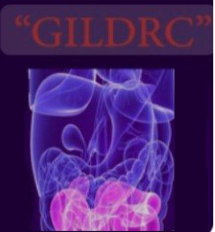
Esophageal Cancer Staging and Treatment
Mohsen Rajabnia M.D.
Assistant Professor of Gastroenterology and Hepatology
ABZUMS

Slide 2
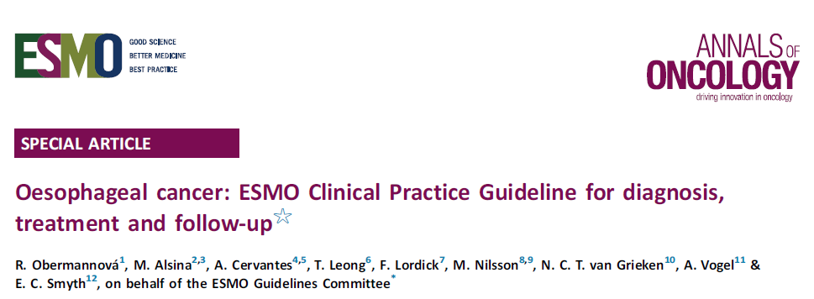

Slide 4
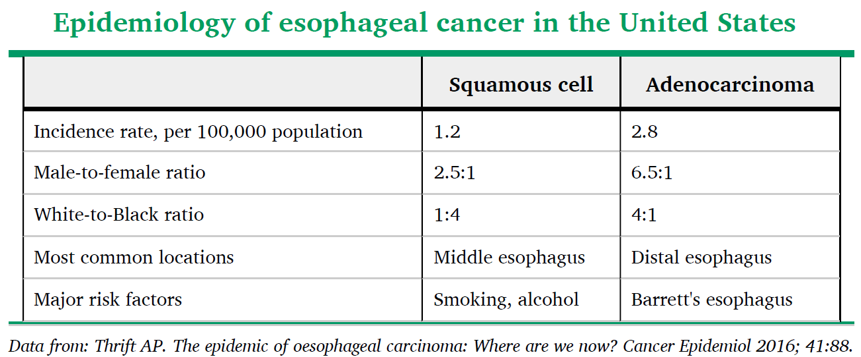

Slide 5
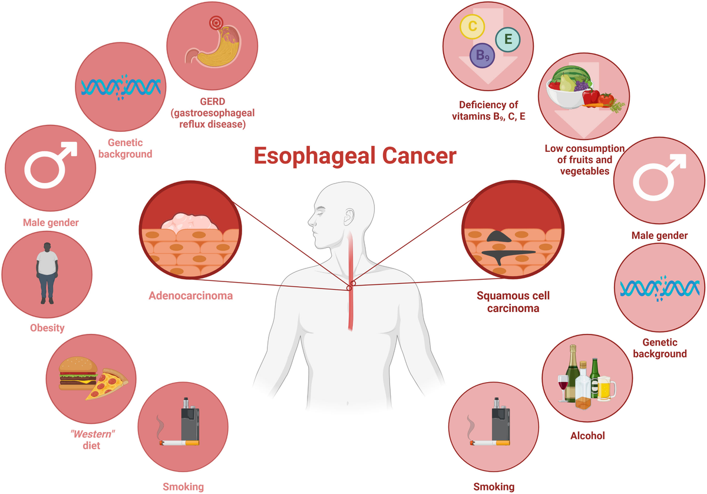

Slide 6
Pretreatment Staging

Slide 7
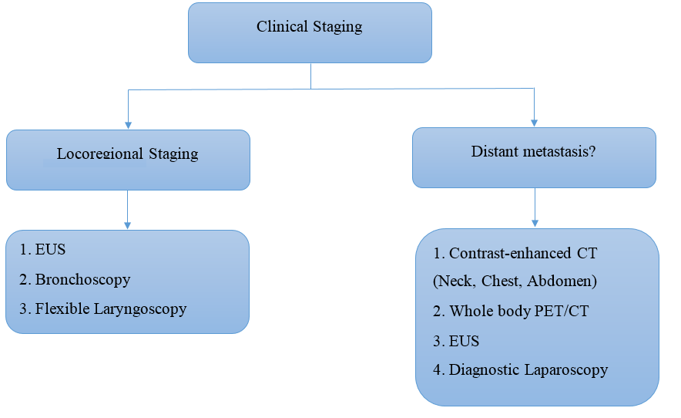

Slide 8
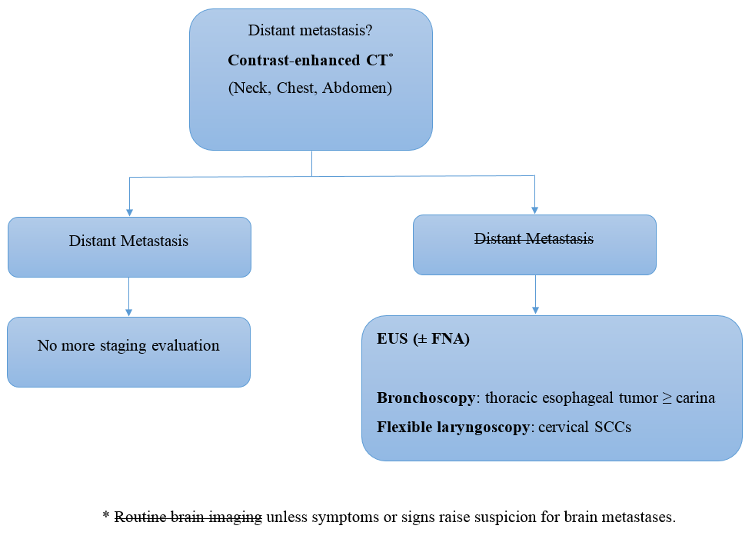

Slide 9
● Preoperative bronchoscopy + biopsy and brush cytology:
as the last investigation in the staging workup for patients with locally advanced, non-metastatic tumors located at or above the carina (ie, upper esophageal and cervical SCCs).
● Flexible laryngoscopy:
cervical SCCs → assess local disease extent and to detect a synchronous malignancy of the head and neck.

Slide 10
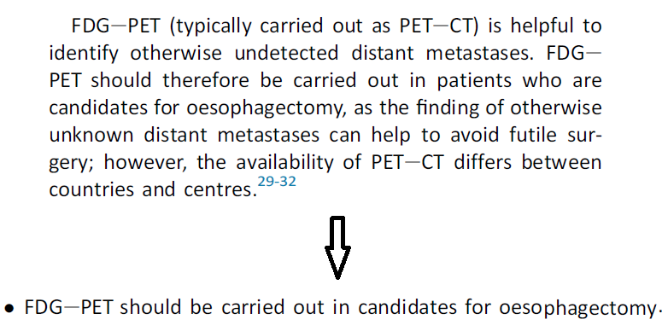

Slide 11
Staging Laparoscopy
● NCCN: "optional" for patients with EGJ tumors and no evidence of metastatic disease.
● ESMO: locally advanced (T3/T4) adenocarcinomas of the EGJ infiltrating the gastric cardia.
● SAGES: candidates for curative resection (early stage esophageal cancer with no evidence of distant or LN metastases) may benefit from staging laparoscopy.

Slide 12
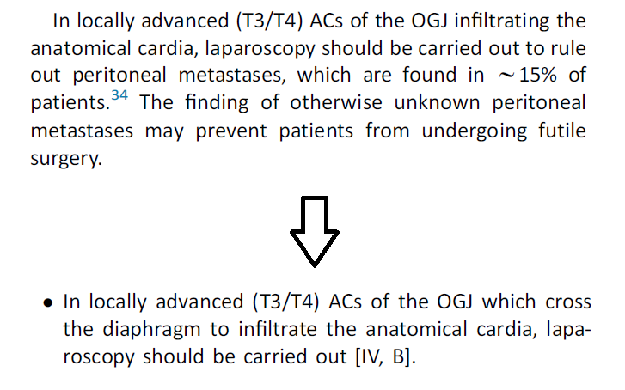

Slide 13
UpToDate: Diagnostic laparoscopy (after conventional pretreatment staging studies)
◦ Potentially resectable
◦ Clinical T3 or T4
◦ Siewert II to III adenocarcinomas of the EGJ
◦ Suspicion for intraperitoneal metastatic disease that cannot otherwise be confirmed.

Slide 14
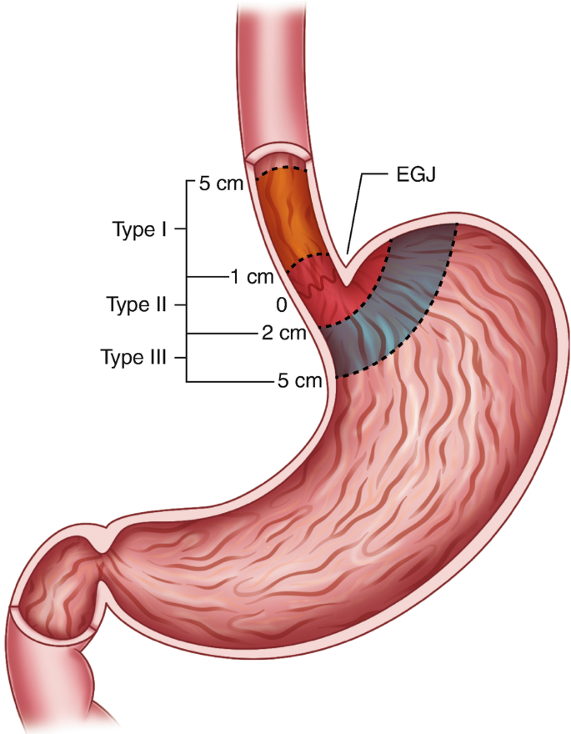

Slide 15
None of these groups provides guidelines for the use of diagnostic thoracoscopy.

Slide 16
Esophageal cancer TNM staging AJCC UICC 8th edition

Slide 19
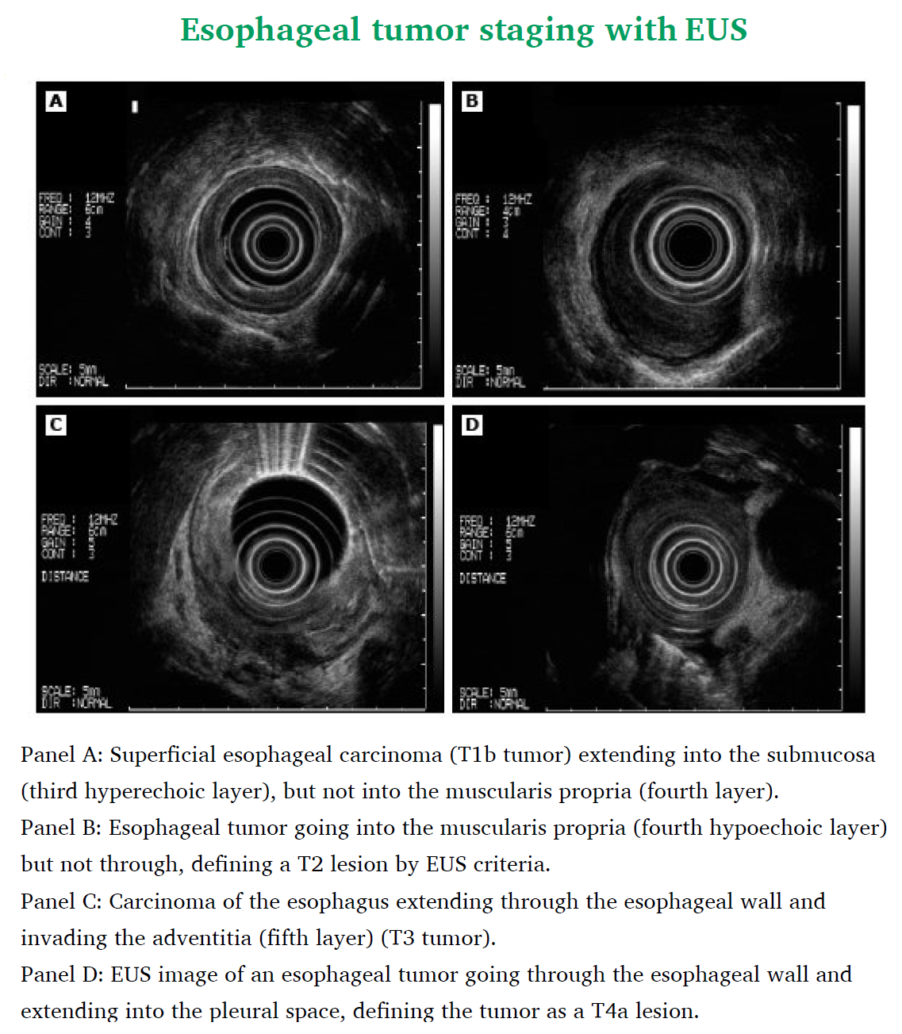

Slide 20
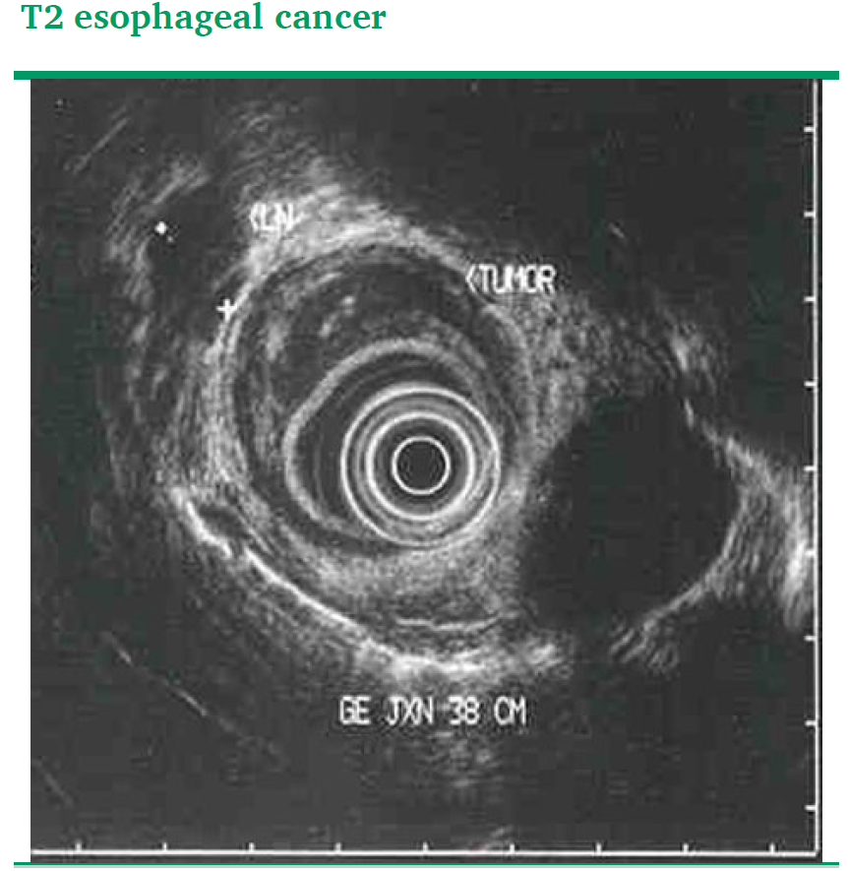

Slide 21
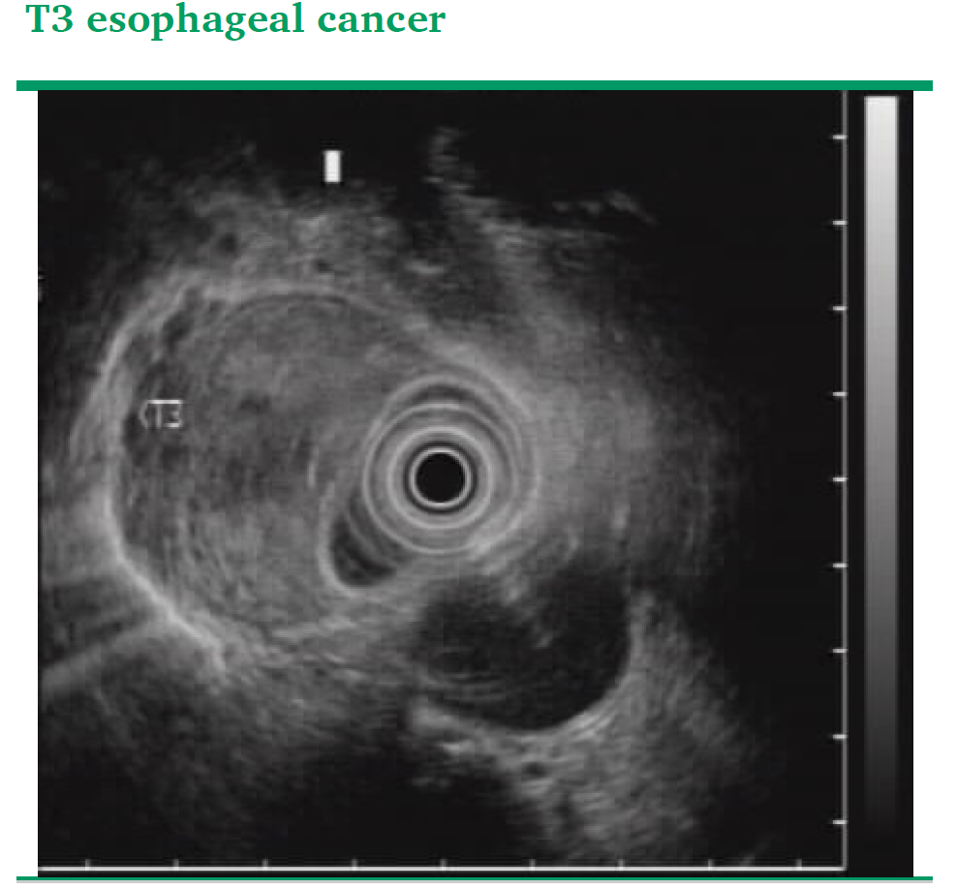

Slide 22
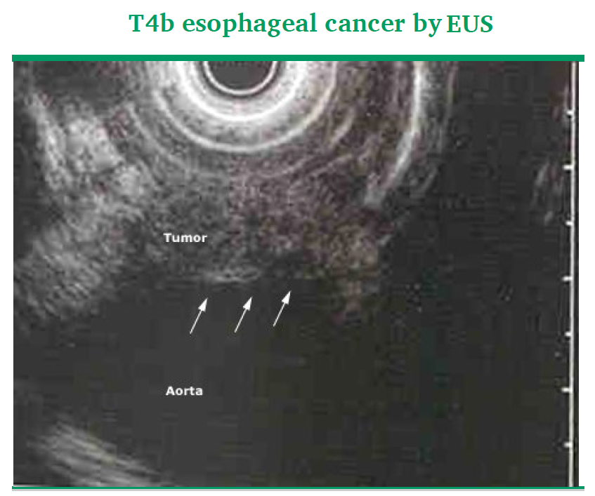

Slide 23
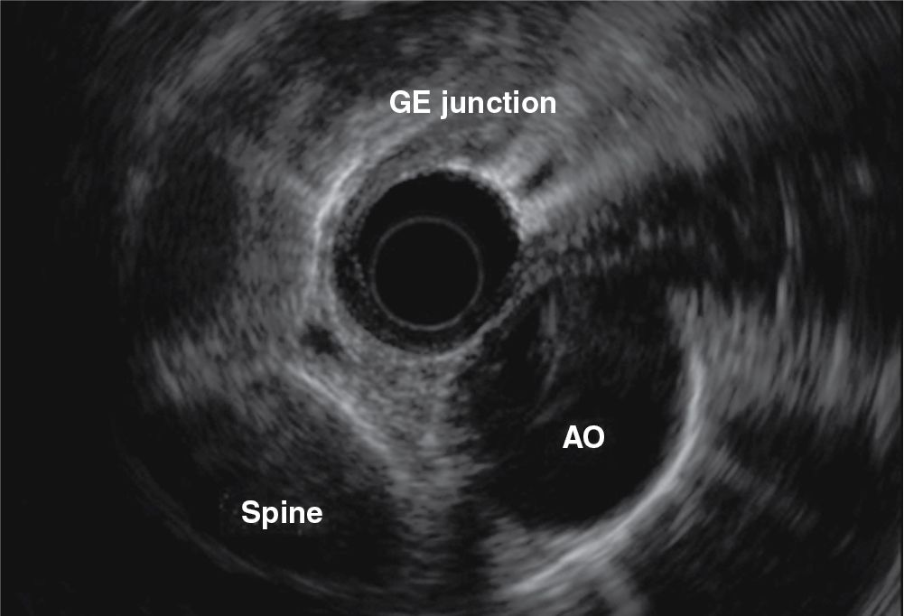

Slide 24
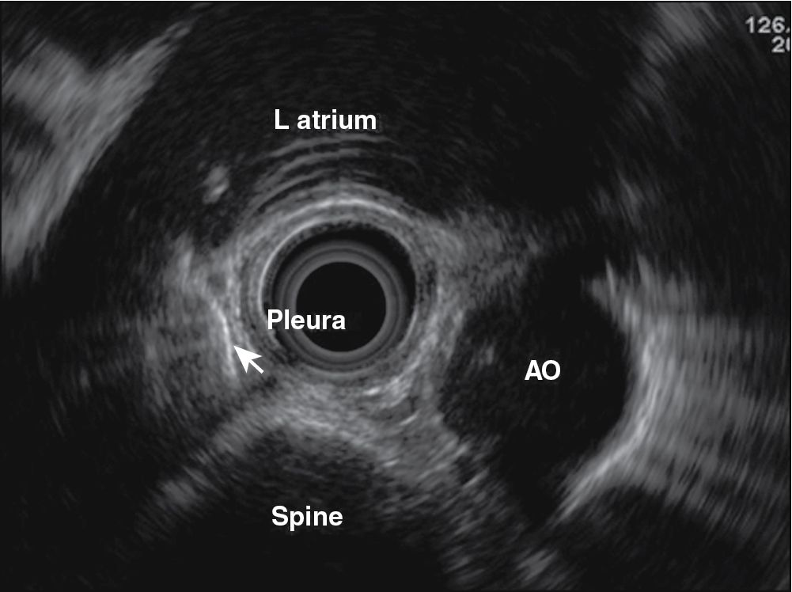

Slide 25
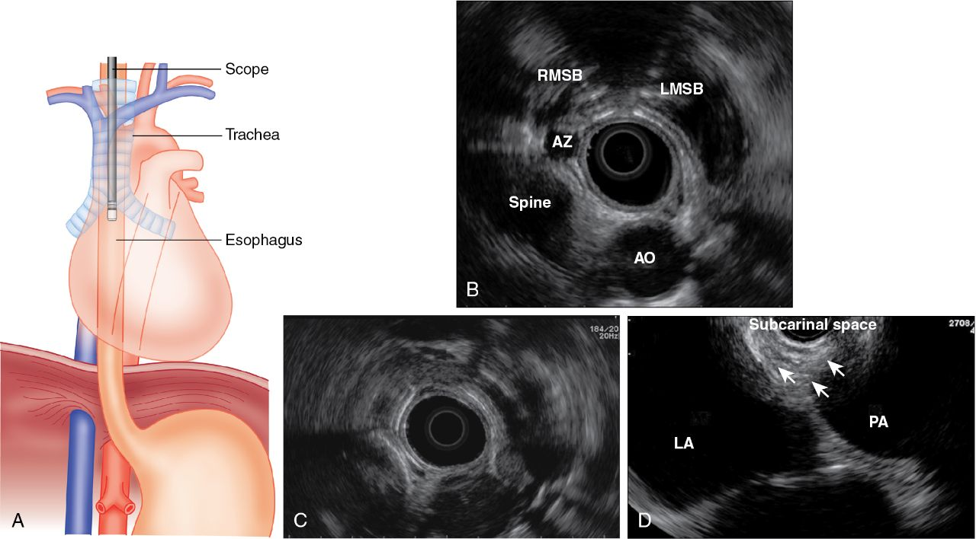

Slide 26
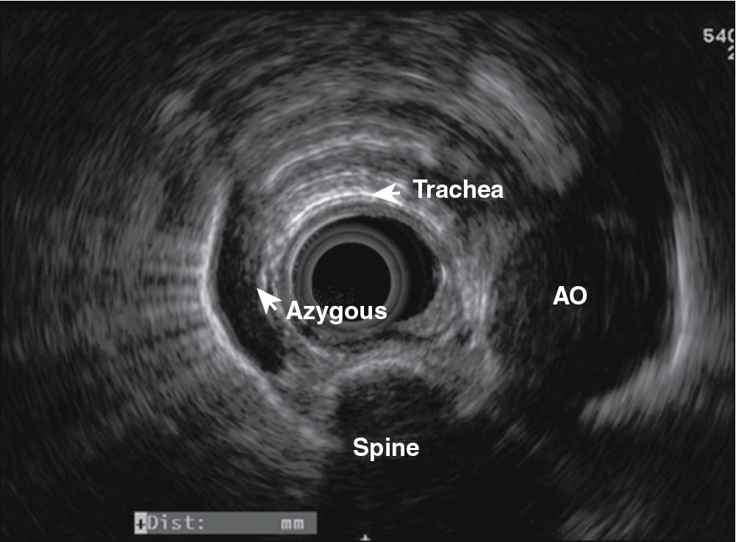

Slide 27
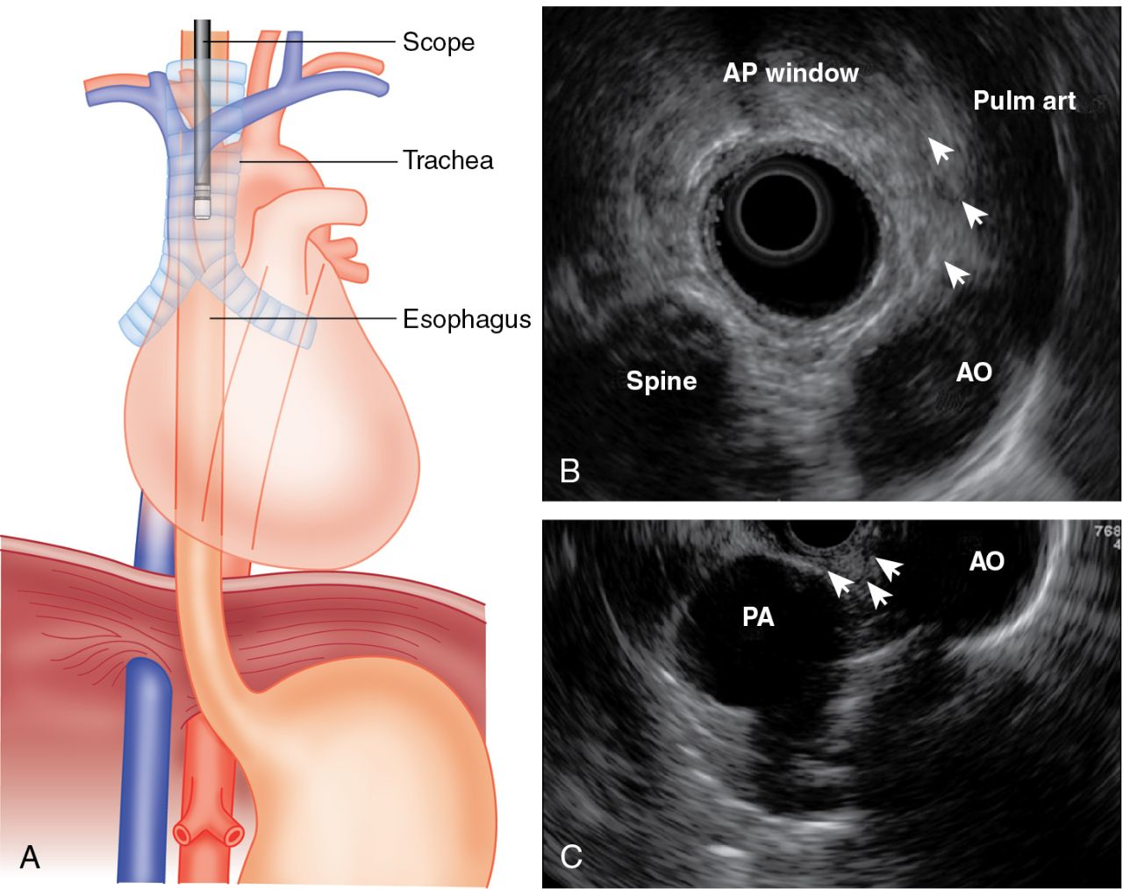

Slide 29
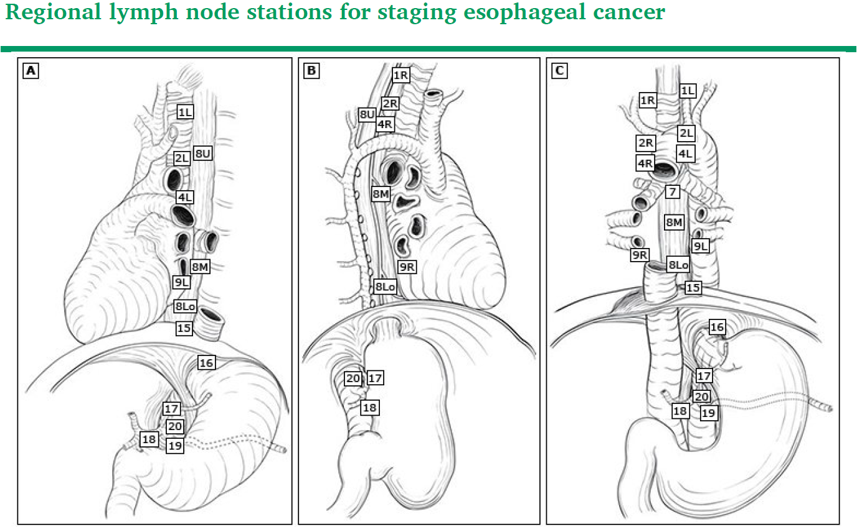

Slide 30
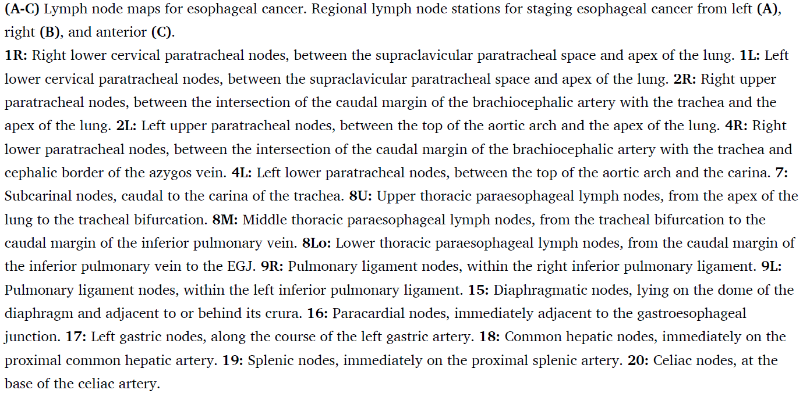

Slide 31
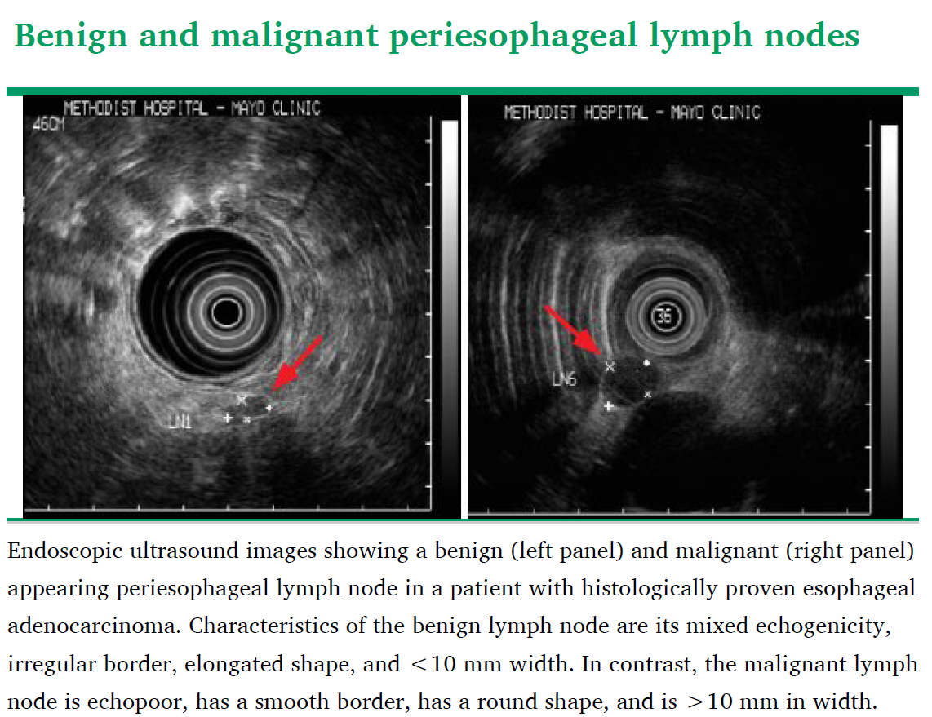

Slide 33
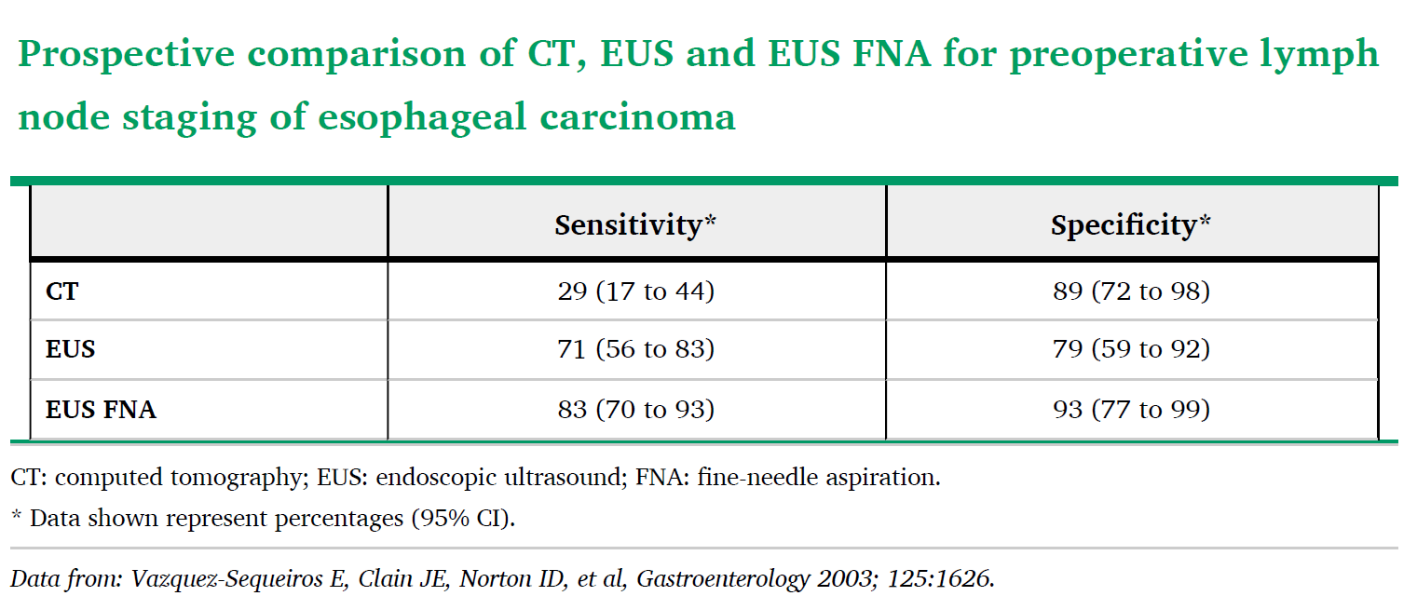

Slide 36
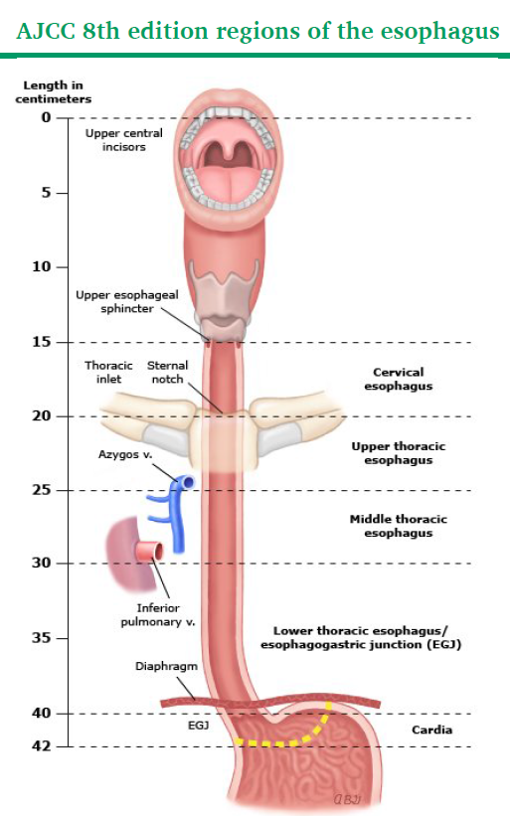

Slide 37
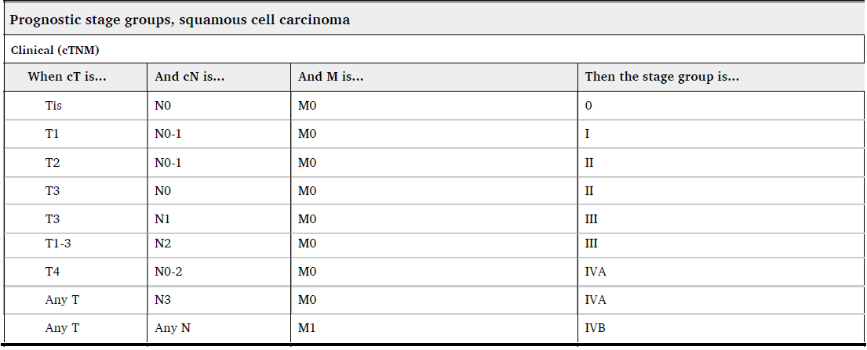

Slide 39
Treatment of Esophageal cancer

Slide 40
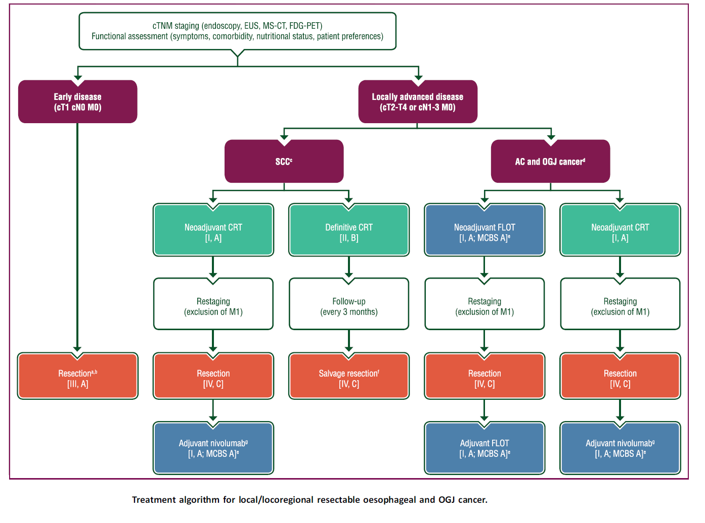

Slide 41
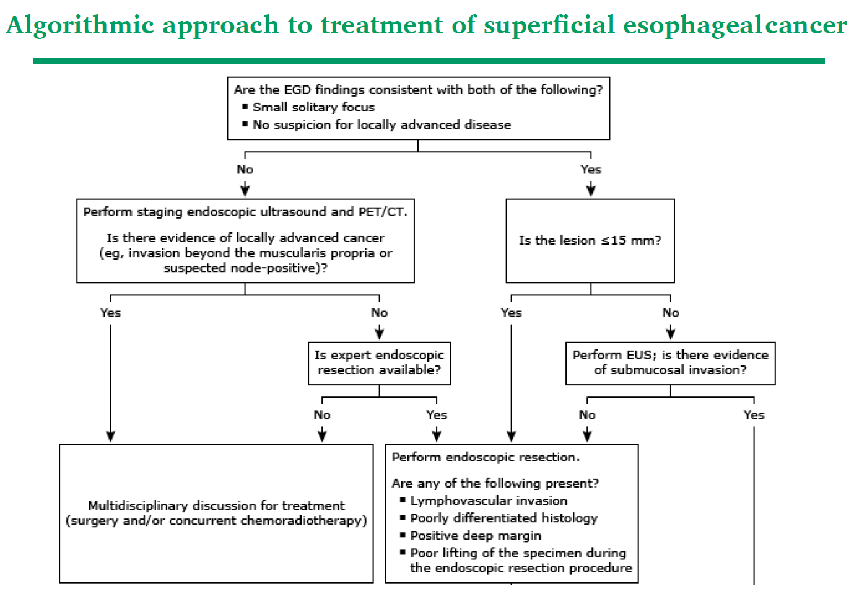

Slide 42
